Slide 1
Evolution of smoking behavior after early withdrawal of a smoking cessation program
C. Pacheco¹, A. Vale², M. Guimarães³, I. Pascoal³
¹Pneumology Department, Hospital de Braga, Braga, Portugal
²Pneumology Department, C Hospitalar de Trás os Montes e Alto Douro, Vila Real, Portugal
²Pneumology Department, Centro Hospitalar de Vila Nova Gaia/Espinho, Gaia, Portugal

Slide 2
Introduction
Tobacco is the leading preventable cause of morbidity and mortality.
Despite the recognized effectiveness of smoking cessation treatments currently available, the results fall short of the desirable.
Poor adherence to treatment programs significantly compromises the therapeutic success.

Slide 3
Introduction
Smokers who are submitted to repeated interventions on smoking cessation have increased likelihood of successful future attempts.
We don’t known how smokers that quit smoking cessation programs behave after that.

Slide 4
Objectives and Methods
Clinical and epidemiological characterization of smokers with early withdrawal in a smoking cessation program (evaluation of tobacco consumption and motivation to quit).
Retrospetive study based on clinical process and applying a telephone questionnaire to smokers who began a program of smoking withdrawal and abandoned the same up to a maximum of 3 interventions, between 2010 and 2011.

Slide 5
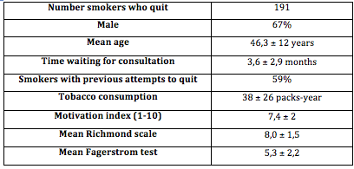
Results
Total patients on program (2010-2011): 417

Slide 6


Slide 7
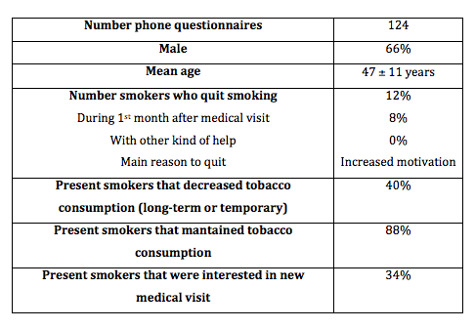
Results

Slide 8
Results
15 smokers left smoking, 10 in the first month after quitting the program.
Increased motivation with the program was the reason quoted by 2/3 of the individuals to success.
About 40% referred cessation or temporary reduction of consumption after the program.
About 88% of individuals still smoked at the time of the study. Half of these did not change the consumption and one-third has decreased the amount of cigarettes per day.
37 smokers showed interest in quitting.

Slide 9
Conclusions
The early abandonment of the treatment program is disturbing and is one of the key factors for failure.
Prolonged abstinence is not negligible (12%).
About 30% of the studied population wants to quit smoking and needs specialized help.

Slide 10
Conclusions
Improved information about chronic character and the need for treatment and follow­up of smoking addiction can reduce dropouts and relapses.
Further studies are needed to understand the impact of smoking cessation programs in patients who quit.

Slide 11
Bibliography
Smoking cessation rates in the United States: A Comparison of Young Adult and Older Smokers. K.M. et al. Am J Public Health. 2008 February; 98(2): 317–322.
Counseling interventions for smoking cessation: systematic review. Alba LH et al. Salud Publica Mex. 2013 Apr;55(2):196-206
A pilot randomized trial of a smoking cessation nursing intervention in cardiac patients after hospital discharge. Cossette S et al. Can J Cardiovasc Nurs. 2012 Fall;22(4):16-26
Efficacy of smoking-cessation interventions for young adults: a meta-analysis. Suls JM et al. Am J Prev Med. 2012 Jun;42(6):655-62. doi: 10.1016/j.amepre.2012.02.013.

Slide 12
Bibliography
Plano Nacional de Saúde da Direcção Geral de Saúde, 2010.
Programas de Cessação Tabágica nos Serviços de Saúde: Uma Estratégia Prioritária de Controlo do Tabagismo. Caracterização do Perfil dos Fumadores e Referenciação numa Consulta de Cessação de um Hospital Distrital da Beira Interior. Mariana Salgado. Tese de Mestrado em Medicina.

